Slide 1

Artificial Intelligence(A1101B) Even Semester Session 2024-25
Tweet Sentiment analysis
Sandeep Kumar (202410116100180)
Preet Kumar (2021410116100147)
Project Supervisor:
Ms. Apoorv Jain
(Assistant Professor)

Slide 2
Introduction
This project leverages Time series and Natural Language Processing (NLP) to analyze public sentiment on COVID-19-related tweets using a pre-trained RoBERTa model.
The system provides interactive visualizations through a web interface built with Gradio.

Slide 3
Objectives
Perform
- Perform sentiment classification on COVID-19 tweets
Develop
- Develop a user-friendly interface for uploading and analyzing tweet data
Visualize
- Visualize sentiment trends and distributions

Slide 4
Technologies Used
Hugging Face Transformers (RoBERTa model)
Gradio (Web UI)
Pandas (Data handling)
Matplotlib (Visualization)
Python
Time series

Slide 5
Data Input Format
CSV File Requirements:
- Mandatory column: 'text'
- Optional column: 'date'
Example:
"The lockdown is frustrating",2021-05-02

Slide 6
Sentiment Classification
RoBERTa Labels:
LABEL_0 → Negative
LABEL_1 → Neutral
LABEL_2 → Positive
Mapped Output:
Negative, Neutral, Positive
Includes confidence scores

Slide 7

Application Workflow
1. Upload CSV
2. Analyze up to 100 tweets
3. Output:
- Sentiment label
- Confidence
- Tweet content
- Date (if available)
4. Generate visualizations:
- Bar chart - Line chart

Slide 8
Gradio Interface
Components:
- File Upload
- Analyze Tweets Button
- Sentiment Distribution Button
- Time Series Button
- Output Textbox and Plots

Slide 9
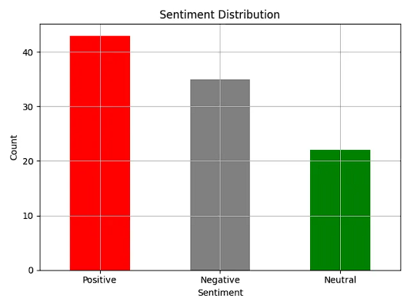
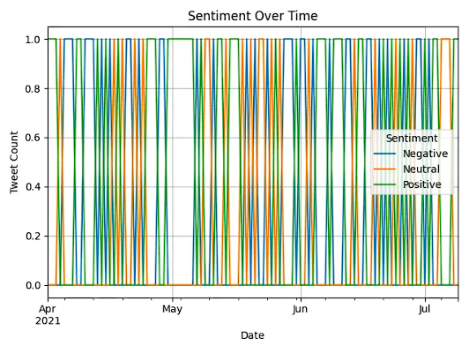
Visualization Examples
1. Bar Chart - Sentiment Distribution
2. Line Chart - Sentiment Over Time

Slide 10
Key Strengths
Transformer-based sentiment analysis
User-friendly interface
Works with or without date data
Easily extendable

Slide 11
Future Enhancements
- Batch processing
- Hashtag/keyword analysis
- Date filtering & thresholds
- Dashboard with Plotly/Streamlit

Slide 12
Conclusion
Demonstrates how transformers + open-source tools can analyze and visualize tweet sentiment in real-time, especially during health crises.

Slide 13
Thank you!

